Slide 1
Actions for your business
W E B I N A R:
How to look after your business health
during the coronavirus crisis
Presented by Matt Topham, Director Practical CFO & Paul Basham, Chartered Accountant, Lighthouse Accounting Services

Slide 2
Common behaviours we’re seeing…
Delayed payments
Aggressive payment terms
Poor communications
Uncertain revenue (sales/clients/projects)
Uncertain investment
More time would help!

Slide 3
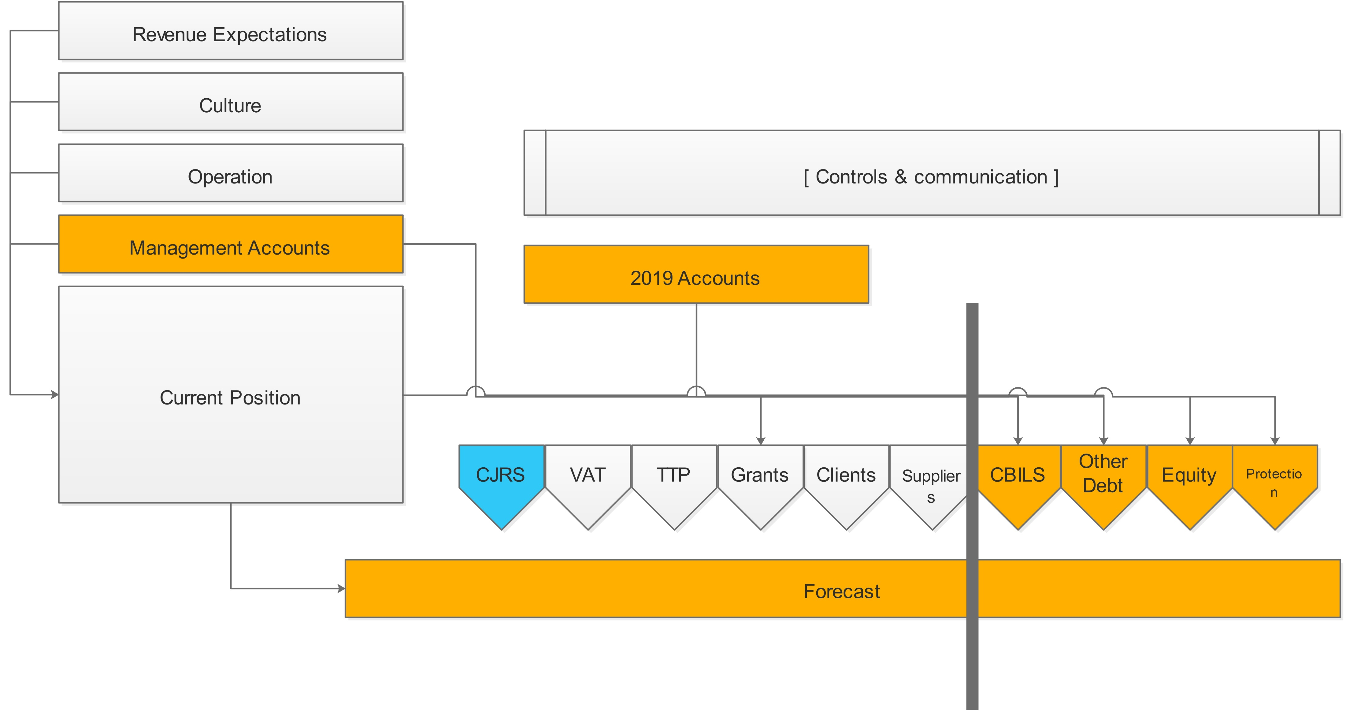
Action plan

Slide 4
CJRS – Job Retention Scheme
Objective – keep people in employment
Can’t work whilst on “furlough”, not be on paid sick leave
80% of salary up to £2,500 per month
Possible backdate to March 1
Covers March/April/May (extension?)
Taxable
Process via HMRC PAYE Online, payment June?
Equality & discrimination law applies
All types of employees

Slide 5
Cashflow management
VAT deferment (Q2 VAT payment not due until 31/3/21)
Time to pay arrangement (TTP) for PAYE, NIC & Corp tax
Talk to customers
Credit control/discounts for volume/interim payments
Talk to suppliers
Materials/suppliers/contractors/landlords

Slide 6
Grants & rates relief &….
All retail, hospitality and leisure businesses in England and Wales will receive a 100% business rates holiday for the next 12 months
Businesses who get SBRR/RRR will receive a grant of £10,000
Slightly larger businesses in retail, hospitality or leisure may qualify for a £25,000 grant
Varying processes
Innovate UK grant
up to £50k to help UK virus resilience
Competition
Beware state aid limits

Slide 7
Coronavirus Business Interruption Loan Scheme (“CBILS”)
For successful businesses but one off hit because of virus; i.e. profitable and cash generating
It’s 100% repayable!
Huge backlog of applications
Varying processes depending on lender (hard to access new lenders)

Slide 8
Coronavirus Business Interruption Loan Scheme (“CBILS”) continued
No personal guarantee under £250k loan. Company liable for full debt – any shortfall after liquidation could be met by government to 80%
To qualify, applicants must
Be UK based, with turnover of no more than £45 million per annum
Operate within an eligible industrial sector (a small number of industrial sectors are not eligible for support or subject to limitations)
State aid

Slide 9
Alternatives…
Example alternatives may be:
Factoring.
Stock financing.
Asset finance (buildings, equipment or vehicles)
R&D advances
Raising personal finance. This could be a loan or mortgage raised by a business owner and the funds introduced into the business.
Care that borrower can repay loans!

Slide 10
Equity
Some businesses funded by shareholders
Request further support
Possible use of advanced subscription agreement to simplify process?

Slide 11
Protection
Where unable to trade through/access enough support
Specialist assistance to take steps
Care on “wrongful trading”

Slide 12
Take control
Keep an eye on what’s important (orders, revenue, or)
Keep cash plans – suggest daily for at least next quarter
Use simple tools simply (e.g pcfo.co.uk/resources)
Be comfortable that you’re making progress
Make multiple applications and have alternative plans
Have conversations – don’t stew
Take advice

Slide 13
Summary
Remember to do the day job!
Buy time
Obtain good quality information

Slide 14
Thank You
Q&A Session will follow

